Slide 1




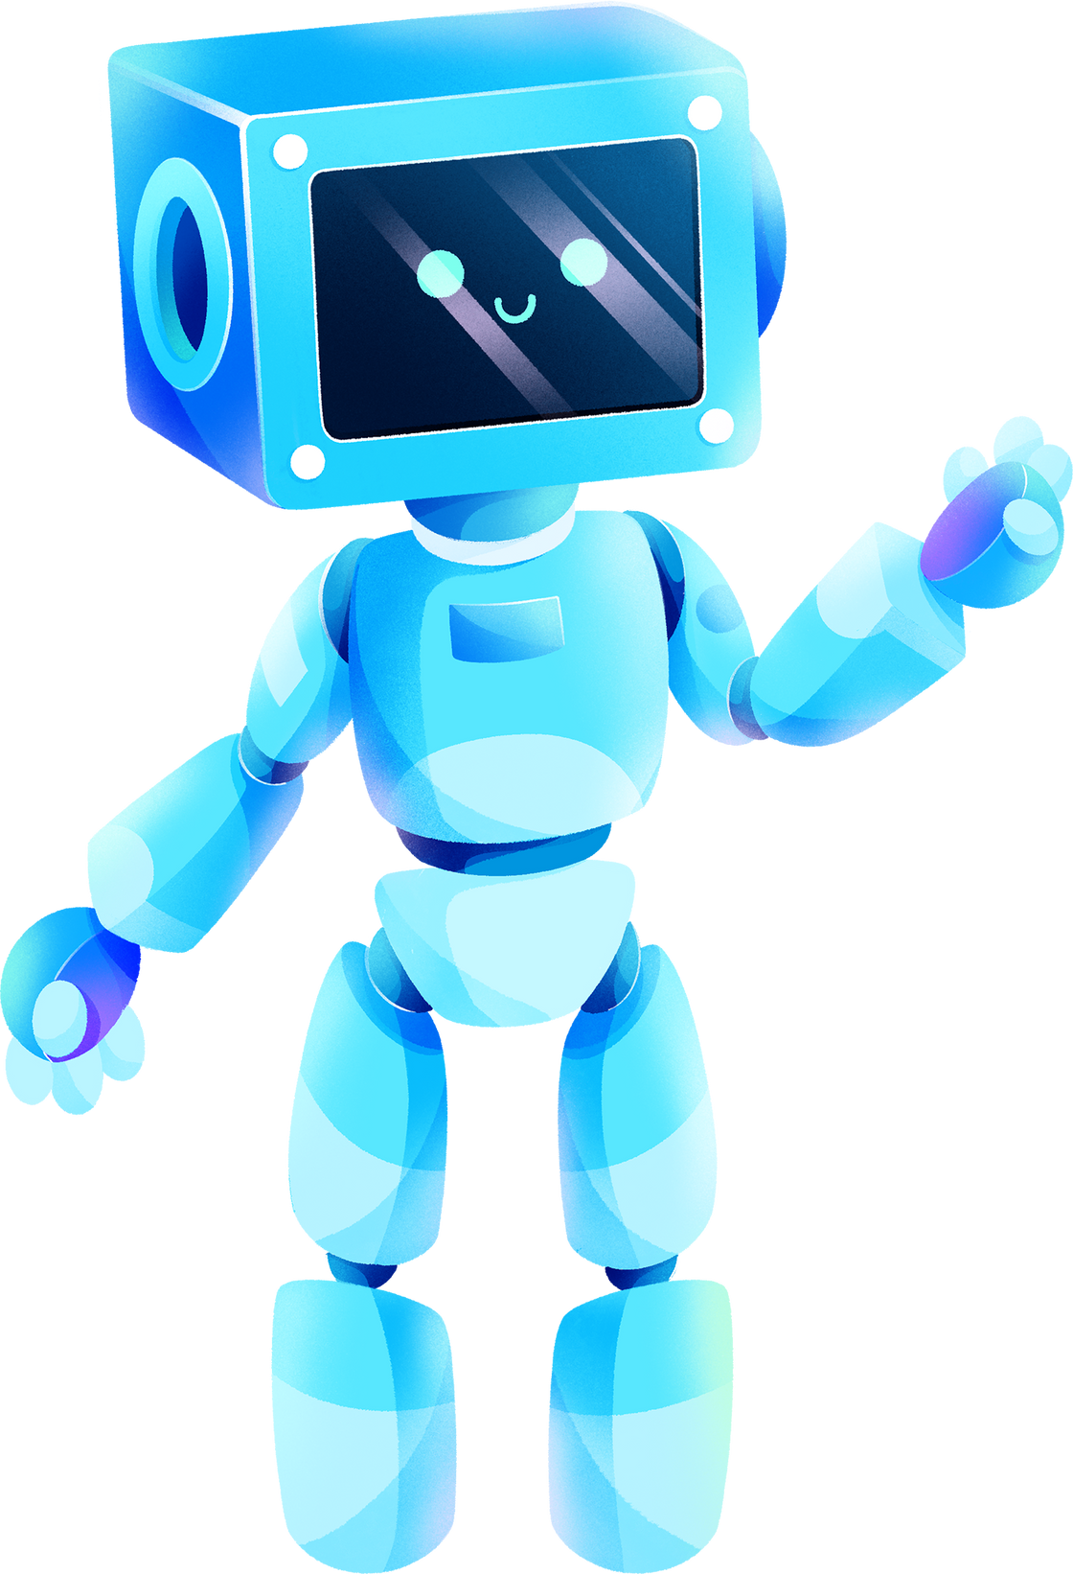
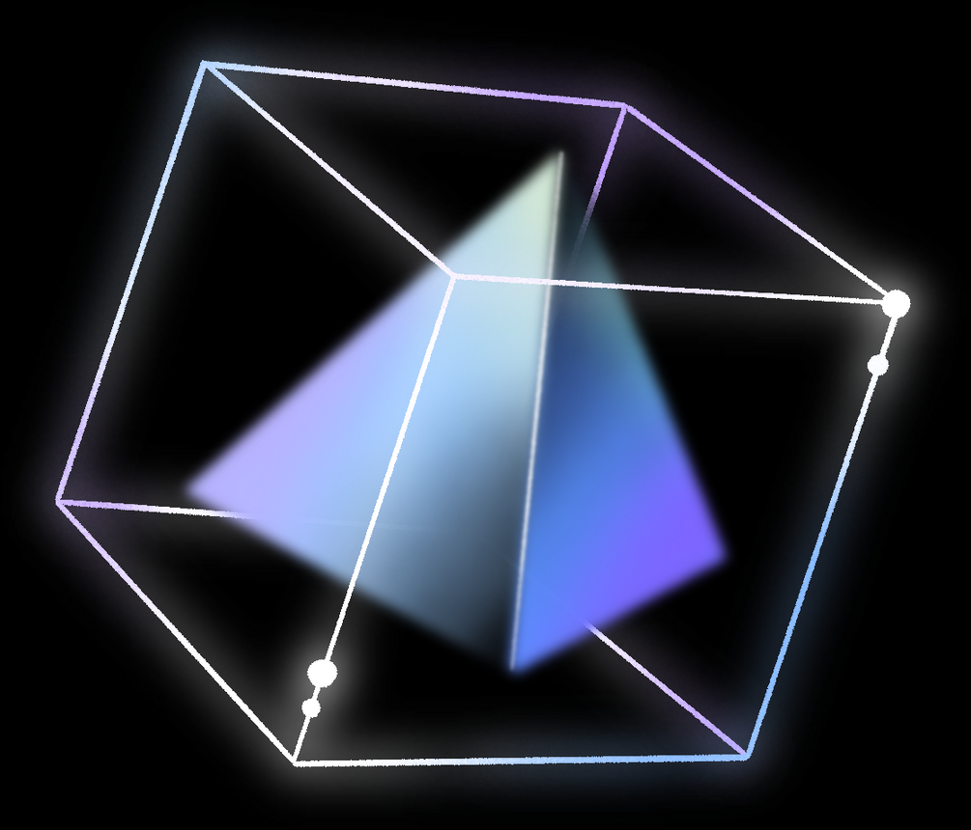
EDUCATIONAL CHATBOT FOR JUNIORS

Slide 2
TABLE OF CONTENTS
Introduction
Project Features
Future Scope
Working
Phases
Prototype
Code
Conclusion
01
02
03
04
05
06
07
08

Slide 3

INTRODUCTION
The educational chatbot is intended to help junior students handle academic and non-academic obstacles. The chatbot will offer students support and direction, assisting them in their academic endeavors and beyond.
School System Integration
The chatbot will be integrated into the school system to provide students with easy access to academic and non-academic resources.

Slide 4







PROJECT FEATURES
FEATURE 01
FEATURE 02
FEATURE 03
24/7 availability and accessibility. The chatbot will be available for students 24/7. Whenever the user have doubt they can clear immediately.
The educational chatbot is intended to help junior students solve question obstacles. The chatbot will offer students support and direction, assisting them in their academic endeavors and beyond.
Non-academic support and resources, such as mental health and wellness resources, financial aid information, and career guidance. The chatbot also sugggests students to take breaks, practice mindfulness, and seek help when needed.

Slide 5
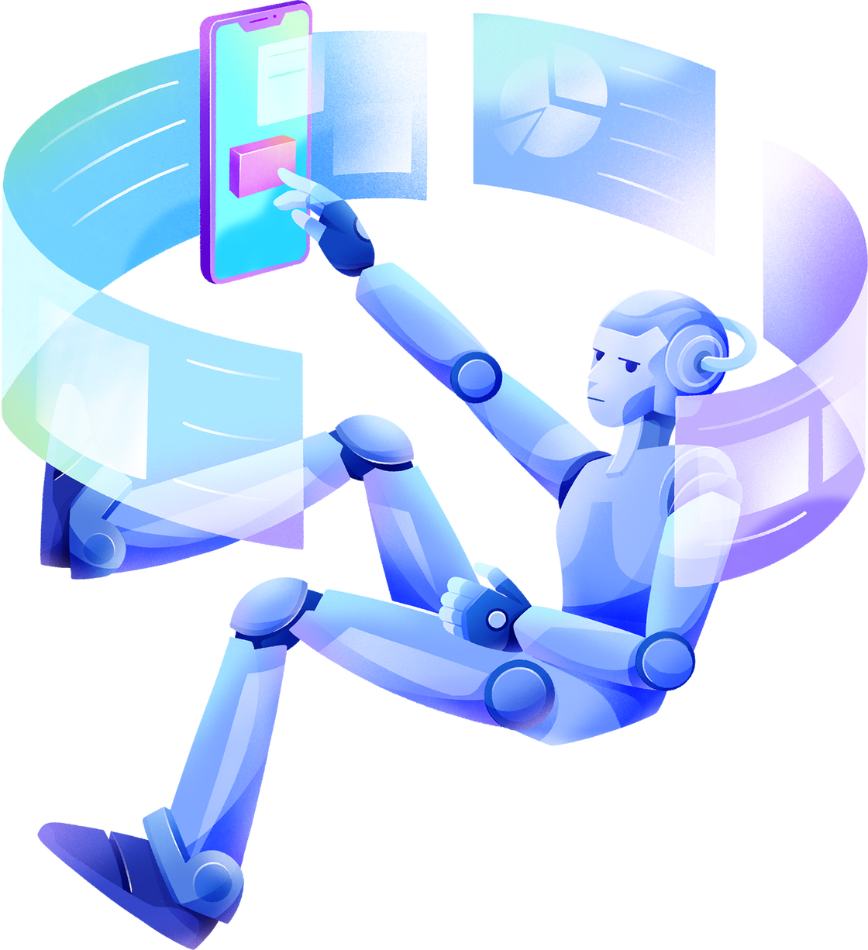

FUTURE SCOPE

Slide 6


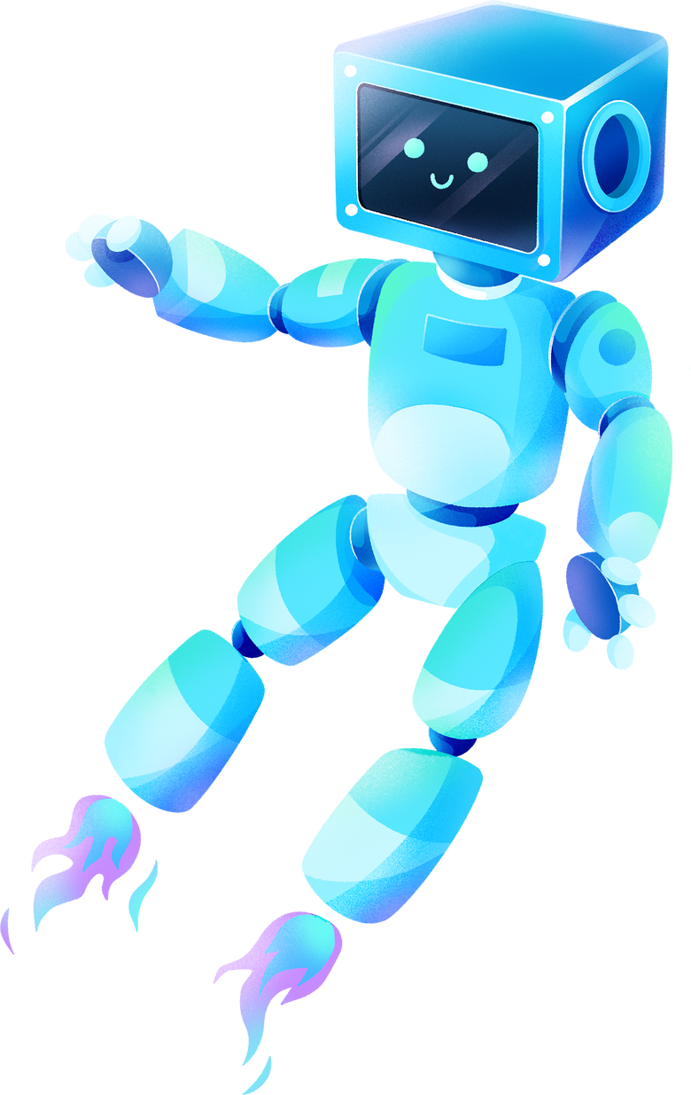



MULTILINGUAL SUPPORT
Add support for multiple languages to make the chatbot accessible to a more diverse audience.
FEEDBACK AND ASSESSMENT
Incorporate mechanisms for providing feedback and assessing user progress. This could include quizzes, assignments, and performance analytics.
VOICE AND SPEECH RECOGNITION
Implement voice recognition and text-to-speech features to make the chatbot accessible to users with different needs and preferences.m.
RESEARCH AND COLLABRATION
Collaborate with educational institutions for research on the effectiveness of your chatbot in enhancing learning outcomes.

Slide 7

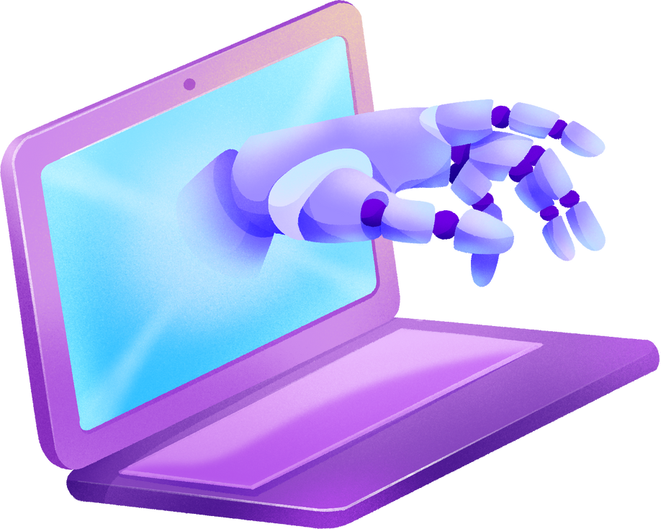
WORKING
User Interface: The chatbot provides a user interface, on a website or mobile app, where users can interact. This interface includes a chat window, input field, and buttons for user engagement.
Text Analysis: When a user enters a message, the chatbot uses various techniques to analyze the text. This includes tasks such as part-of-speech tagging, and entity recognition to understand the user's intent and extract relevant information.
Retrieval: The chatbot queries the knowledge base to fetch information that is pertinent to the user's request. It searches for answers within its stored data.
Response: After retrieval of data chatbot generates a response it can be in the form of text or documents.

Slide 8

PHASES
01
02
03
04
USER INTERFACE
Creation of user interfac
various web pages will be created
INTEGRATION OF API’S
Various API’S will be integrated.
BACKEND
Developing the backend of the project.completion ans connection of databases .
FUTURE ENHANCEMENTS AND TESTING
Further testing of the project is done with future enhancements to be tested and added.

Slide 9
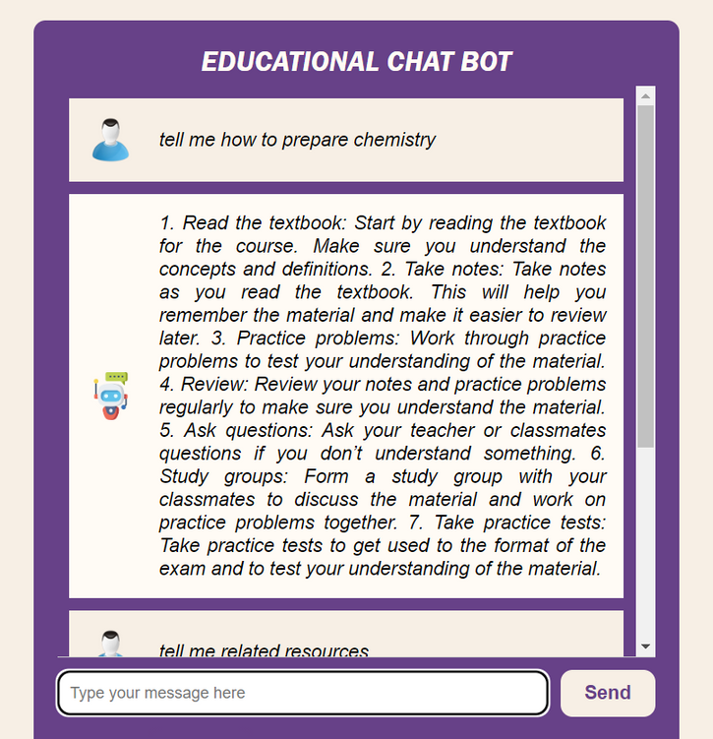
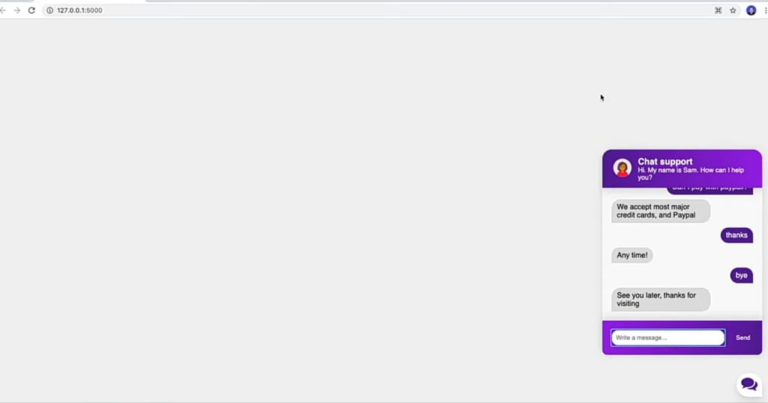
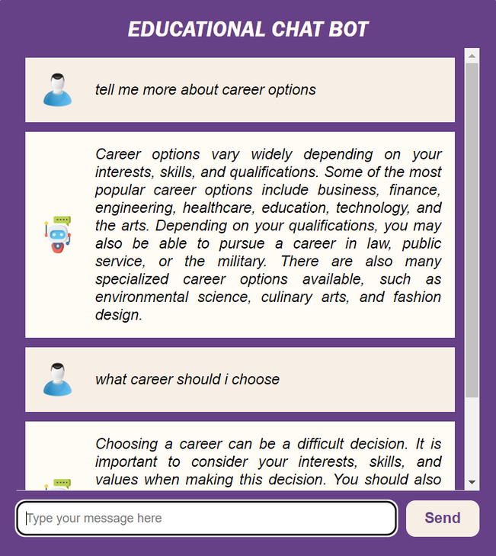
Prototype

Slide 10


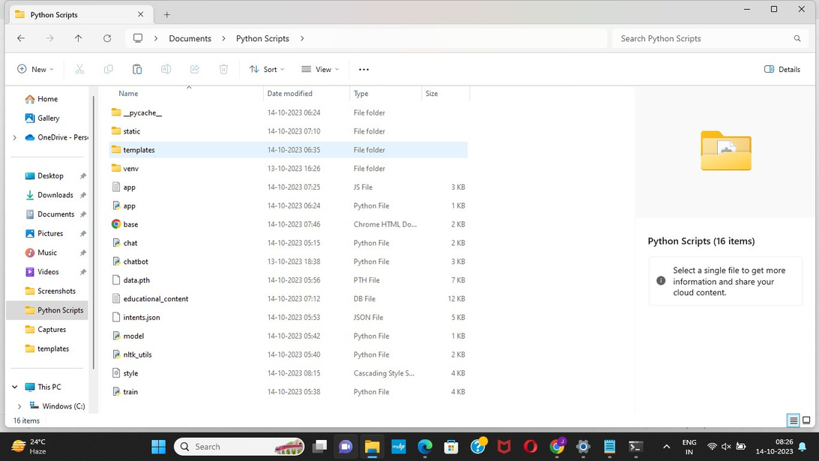

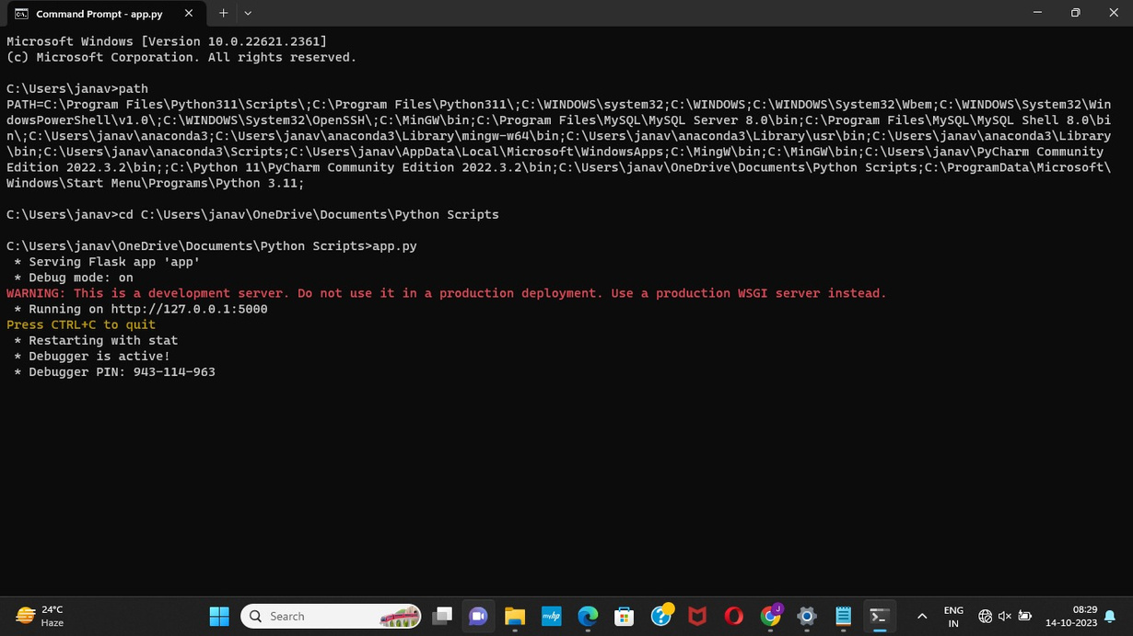
CODE
class Chatbox {
constructor() {
this.args = {
openButton: document.querySelector('.chatbox__button'),
chatBox: document.querySelector('.chatbox__support'),
sendButton: document.querySelector('.send__button')
}
this.state = false;
this.messages = [];
}
display() {
const {openButton, chatBox, sendButton} = this.args;
openButton.addEventListener('click', () => this.toggleState(chatBox))
sendButton.addEventListener('click', () => this.onSendButton(chatBox))
const node = chatBox.querySelector('input');
node.addEventListener("keyup", ({key}) => {
if (key === "Enter") {
this.onSendButton(chatBox)
}
})
}
toggleState(chatbox) {
this.state = !this.state;
if(this.state) {
chatbox.classList.add('chatbox--active')
} else {
chatbox.classList.remove('chatbox--active')
}
}
onSendButton(chatbox) {
var textField = chatbox.querySelector('input');
let text1 = textField.value
if (text1 === "") {
return;
}
let msg1 = { name: "User", message: text1 }
this.messages.push(msg1);
//http://127.0.0.1:5000/predict
fetch($SCRIPT_ROOT + '/predict', {
method: 'POST',
body: JSON.stringify({ message: text1 }),
mode: 'cors',
headers: {
'Content-Type': 'application/json'
},
})
.then(r => r.json())
.then(r => {
let msg2 = { name: "Sam", message: r.answer };
this.messages.push(msg2);
this.updateChatText(chatbox)
textField.value = ''
}).catch((error) => {
console.error('Error:', error);
this.updateChatText(chatbox)
textField.value = ''
});
}
updateChatText(chatbox) {
var html = '';
this.messages.slice().reverse().forEach(function(item, index) {
if (item.name === "Sam")
{
html += '<div class="messages_item messages_item--visitor">' + item.message + '</div>'
}
else
{
html += '<div class="messages_item messages_item--operator">' + item.message + '</div>'
}
});
const chatmessage = chatbox.querySelector('.chatbox__messages');
chatmessage.innerHTML = html;
}
}
const chatbox = new Chatbox();
chatbox.display();

Slide 11
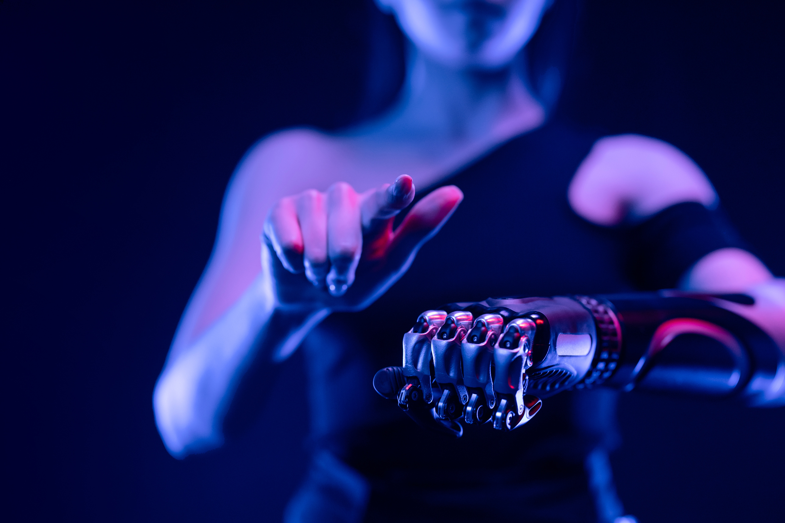
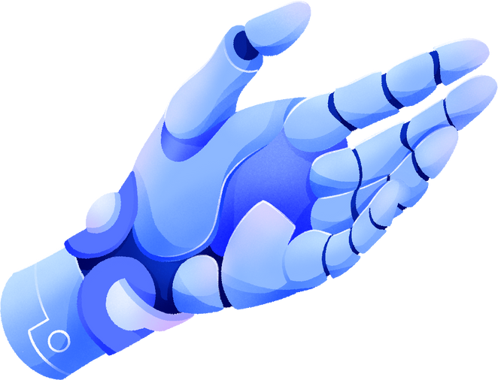
CONCLUSION
The educational chatbot empowers junior students to navigate challenges.
Provides guidance on academic and non-academic matters.
Contributes to their holistic growth and development.

Slide 12
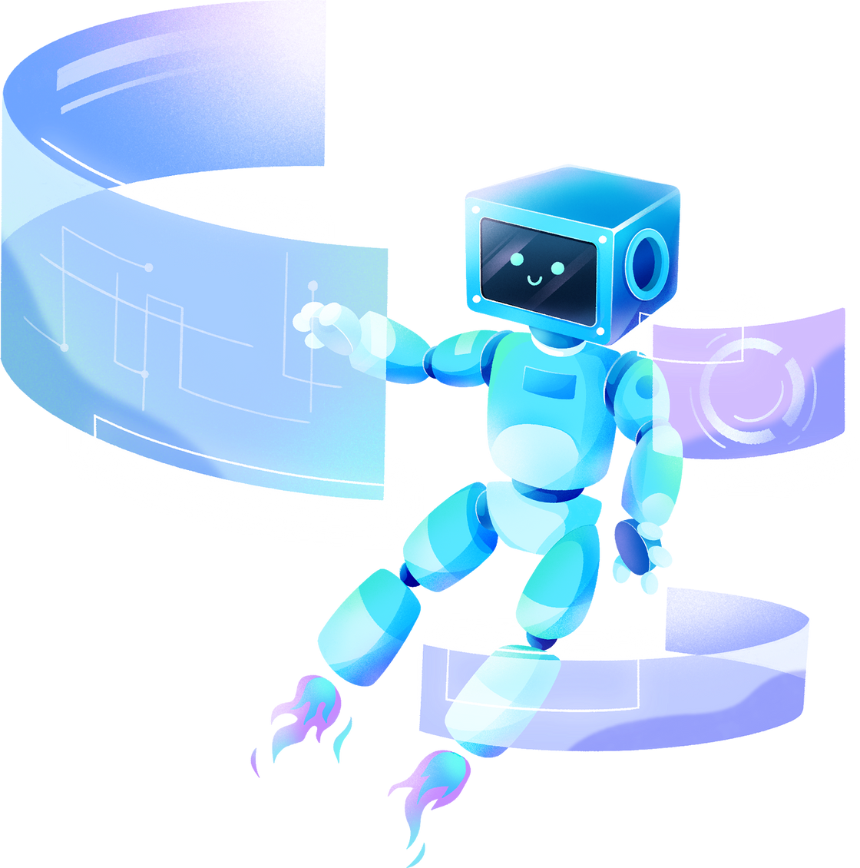
THANK YOU!

